Slide 1


IOE, Pulchowk Campus
March 17th, 2023
Critical
Path
Analysis
Project by:
Anil Paudel - 077BCT010
Ashim B. Karki - 077BCT013
Bishal Aryal - 077BCT021

Slide 2

What is CPA?
Critical path analysis (CPA) is a:
Project management technique
Maps out every key task
It includes identifying the amount of time necessary to finish each activity
The dependencies of each activity on any others
Then calculation of minimum time to complete a project

Slide 3
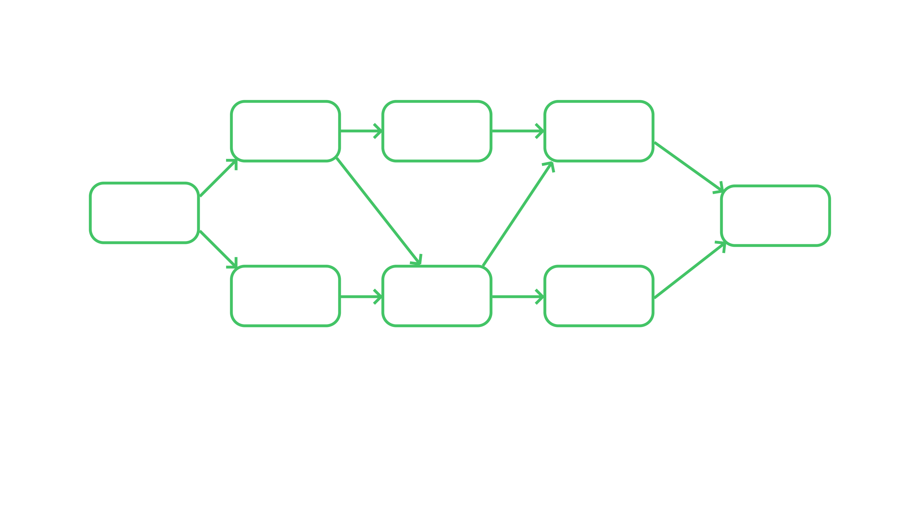
TR = Time Required in Days
For example
TR = 3
TR = 15
TR = 12
Creating
Wireframes
Backend
Development
Testing &
Debugging
TR = 0
TR = 0
Start
Demo
Launch
TR = 8
Content
Creation &
Addition
Designing
UI
Frontend
Development
TR = 17
TR = 6
Total time required to complete the project = 37 days

Slide 4
Methodology
By the use of Graph DS, Topological sorting and PERT Chart.

Slide 5
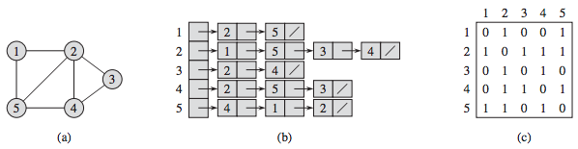
Graph Data Structure
Graph is a:
Graph is a non-linear data structure consisting of vertices and edges
Vertices: Vertices are the fundamental units of the graph
Edges: Edges are drawn or used to connect two nodes of the graph
The following two are the most commonly used representations of a graph:
1. Adjacency Matrix
2. Adjacency List (used in our project)
Digraph
Adjacency List
Adjacency Matrix

Slide 6
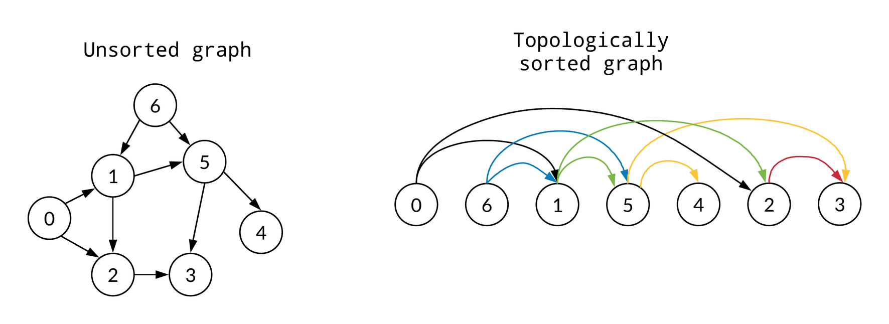

Topological sorting
Topological Sorting is a:
Graph traversal
Each node v is visited only after all its dependencies are visited
Possible only if it is a directed acyclic graph (DAG)

Slide 7
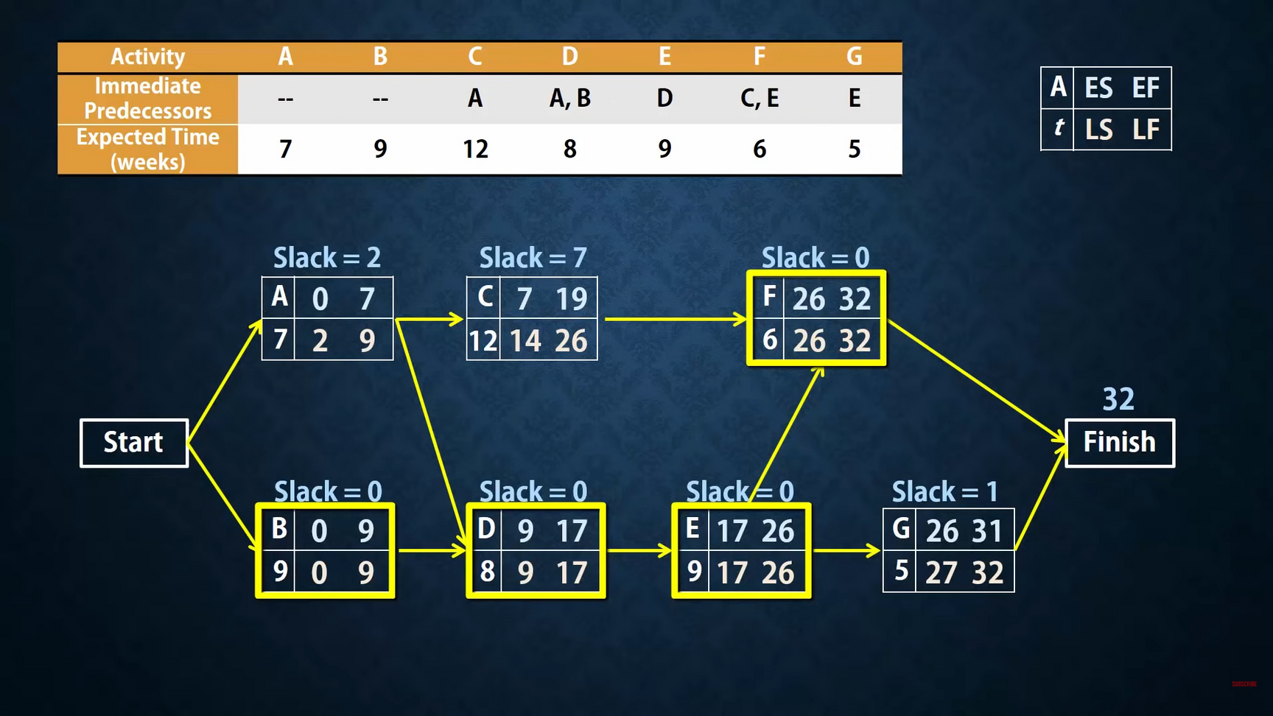

PERT Chart

Slide 8

Graph visualization
SFML
SFML:
Provides a simple interface to the various components of your PC, to ease the development of games and multimedia applications.
Is perfect for writing 2d games and applications of any size or complexity at all.
Is highly object oriented compared to other graphics libraries so perfect for the use in our case of C++ programming.
It is setup by:
Including #include <SFML/Graphics.hpp> after all the header and dll files are included in the IDE.

Slide 9
DEMO
In Visual Studio

Slide 10
Thank You!
Find our project on Github
All files have already been included. Just download and run in Visual Studio IDE!

